Slide 1
Tableau Visualization
By: Tushar Goel
BDS BATCH
25 MAY

Slide 2
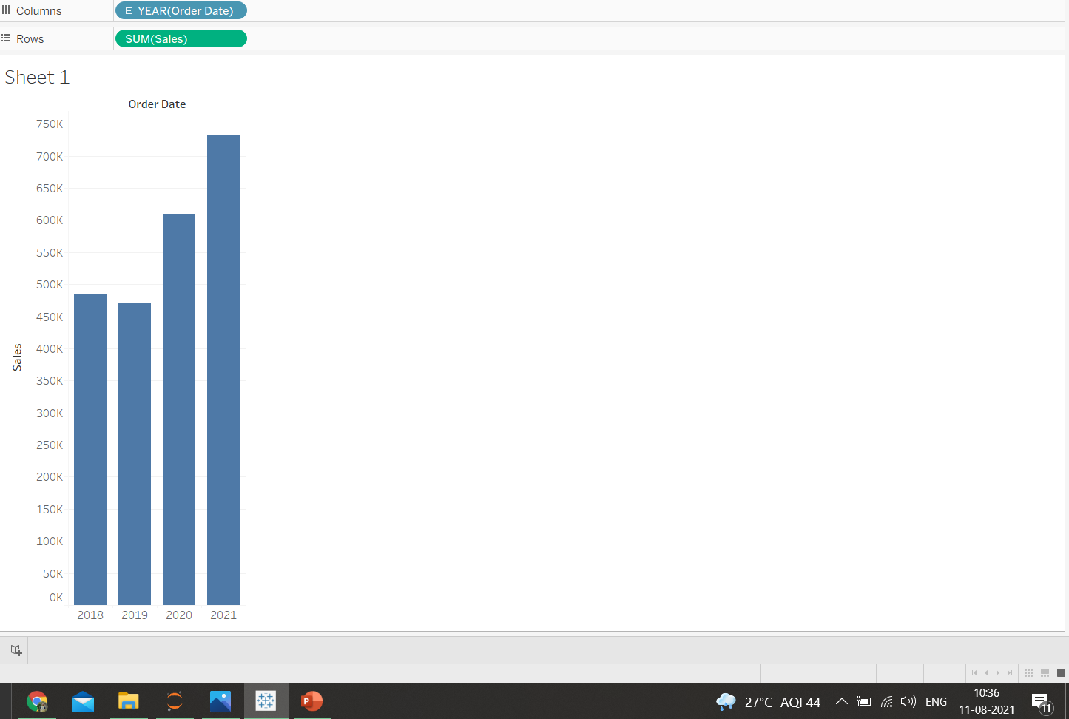
1.Find the sales for every year and find the highest sales and show the view in bar graph.

Slide 3
1.Find the sales for every year and find the highest sales and show the view in bar graph.
The highest sales Is in 2021 which is 733215.

Slide 4
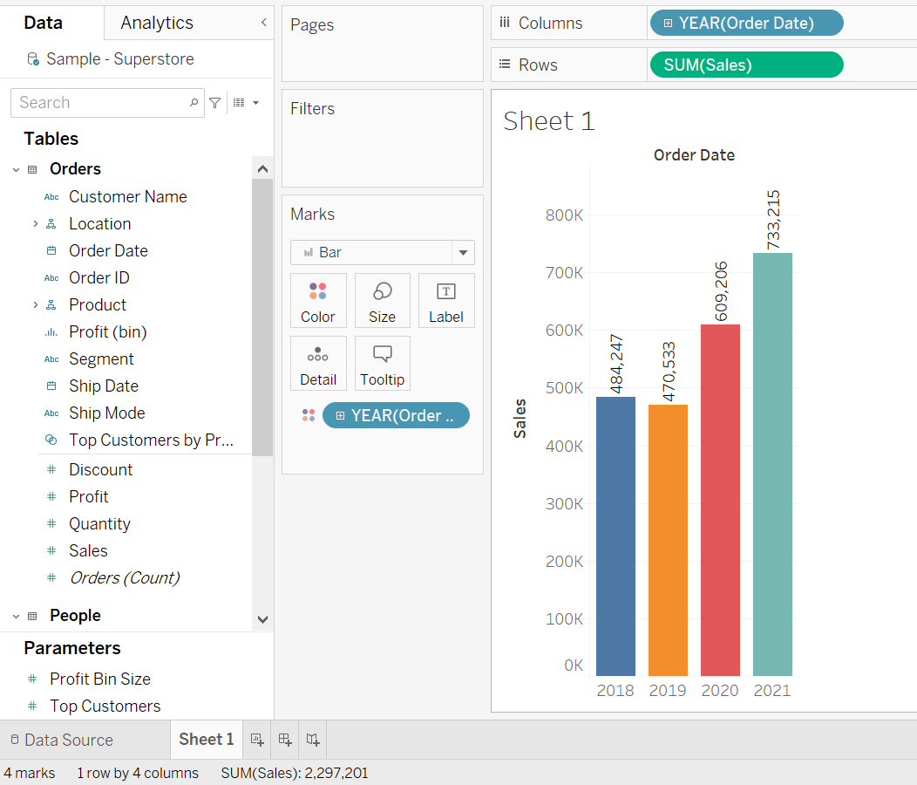
2.Add label to your view

Slide 5
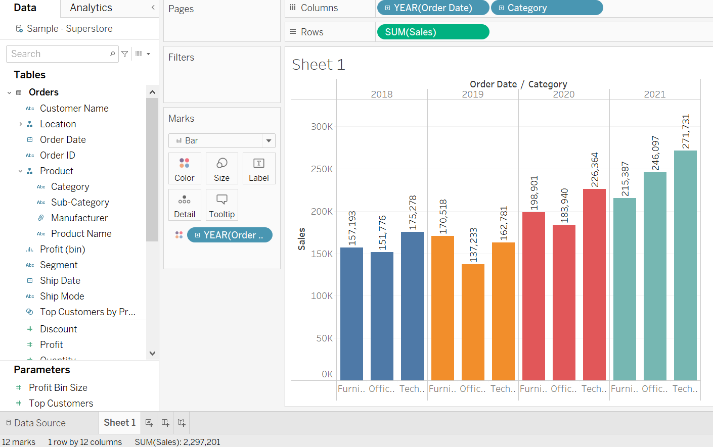
3.Find the category wise sales for every year

Slide 6
4. Which category has highest sales in the year 2020 & 2021.
Here by looking to graph the visualization is that Technology category has the highest sales in the year 2020 as well as 2021.

Slide 7
5.Based on the analysis of the year 2020 and 2021,give some suggestions to improve sales in the year 2022.
As in the year 2020 and 2021,technology has the highest sales so the main focus should be provided to technology sector for increasing profits in the year 2022.
As technology has been on increase for past two years, proving that there is a probability for an increase in technology so we can focus part of the marketing and advertising to the furniture and office supplies as a subcategory to increase the sales in the year 2022.

Slide 8
6. Display subcategory and find some insights from the view about max and min sales under every category.
In the year 2020, category of furniture which is the sub-category of category column which have the highest no. of sales as 83919 and furnishing has the lowest no. as 27874 .
In the year 2020,category of office supplies we see that storage have the highest number of sales of 45408 and fasteners of 960 which is the lowest
In the year 2021,category of furniture we see that chairs still has the highest number of sales of 83919 meaning good growth in this sub-category and furnishing of 28915 which is the lowest but a slight increase in from last year
In the year 2021,category of office supplies we see that binders have the highest number of sales of 72788 which beats storage by more than 50% shows great growth and fasteners of 858 which is the lowest,it has decreased from last year,a full revaluation of the entire department should be done to find the inefficiencies and improve them.

Slide 9
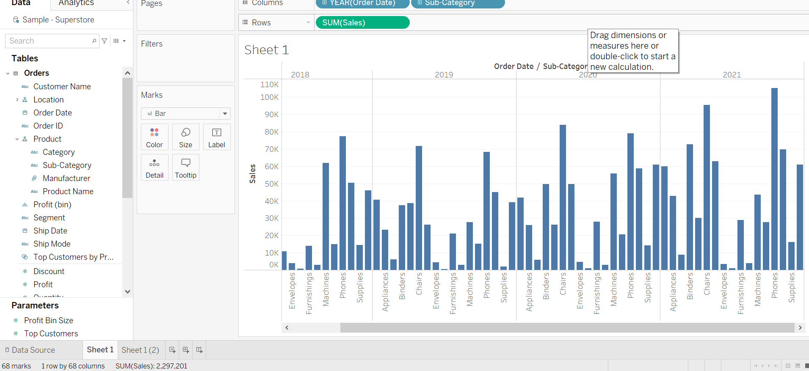
6. Display subcategory and find some insights from the view about max and min sales under every category.

Slide 10
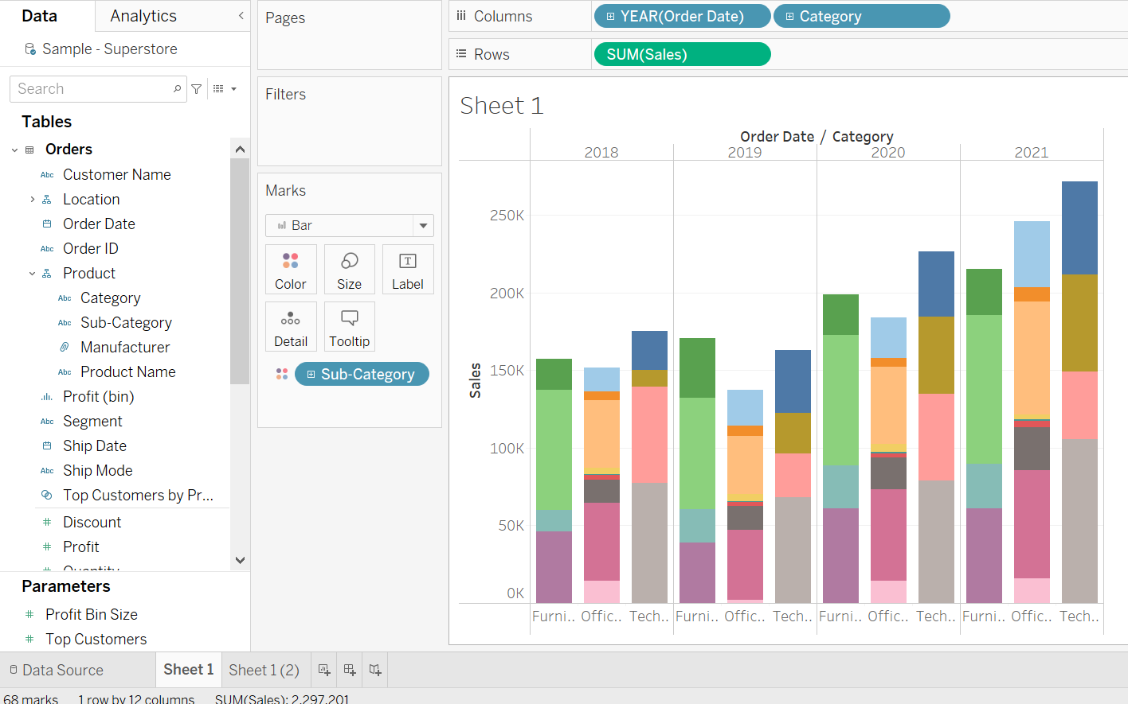
8. In your bar graph, present sub-category under each bar of category using color card.

